Slide 1



Creating a Galaxy Cluster Simulation to Constrain Cosmology
Keenan Fiedler
Dr. Eduardo Rozo, Dr. Andres Salcedo
University of Arizona

Slide 2
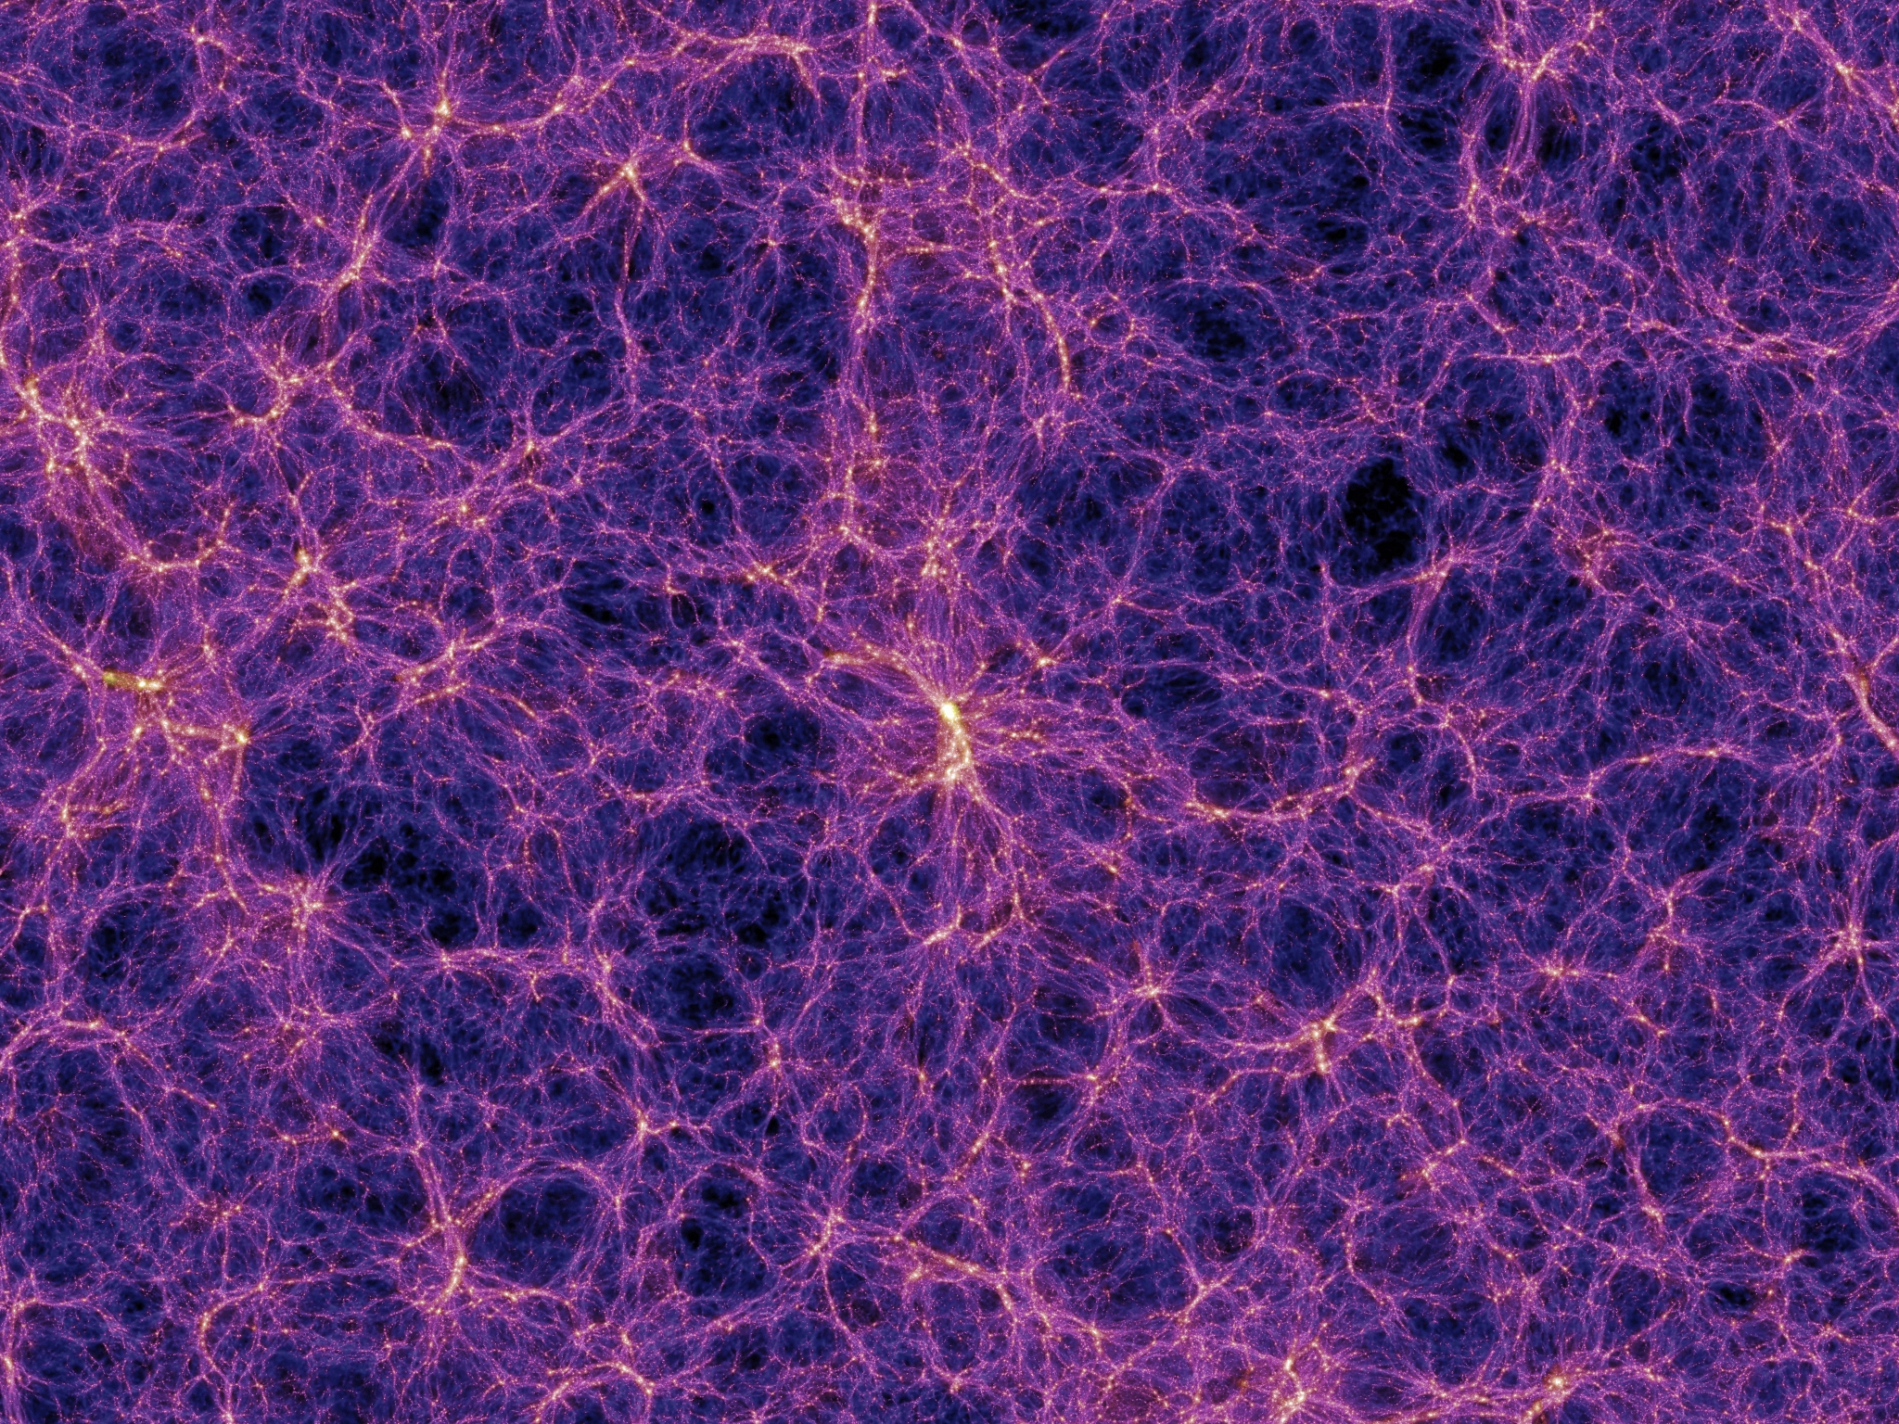
Cosmic Structure
Vast majority of matter is dark matter, invisible to telescopes
Visible matter cannot form galaxies without help
Galaxies connect to underlying dark matter, forming at clumps in the dark matter called “halos”
How can we connect galaxies to dark matter?
Image Credit: Springel et al. (2005)
2

Slide 3
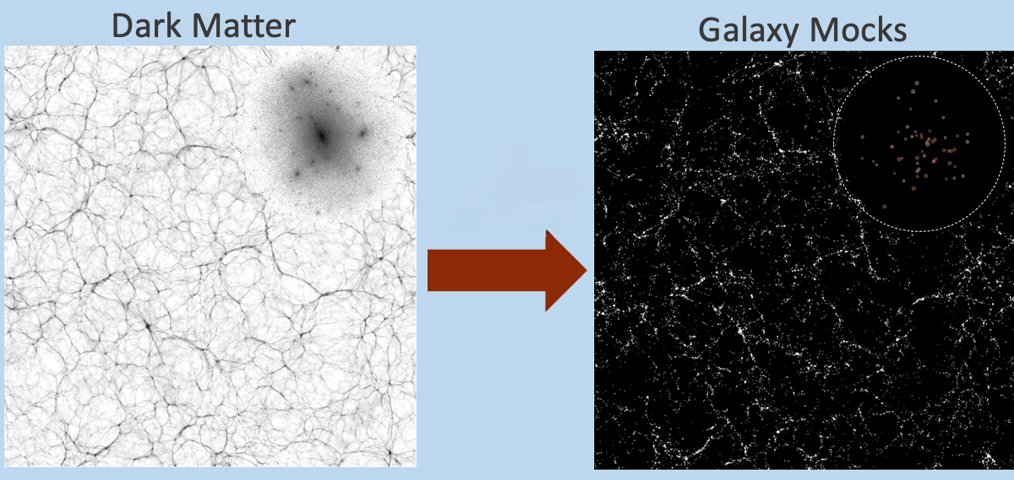
Simulation Based Inference
Use simulations to create a fake universe
Control all aspects of fake universe to imitate real data
Infer information by comparing using a galaxy cluster finder
Image Credit: To et al. (2023)
3

Slide 4
Transforming Dark Matter into Galaxies
Given a dark matter halo
Choose number of galaxies
Give each galaxy the data a galaxy survey would have
Know all properties and parameters of simulation
Image Credit: To et al. (2023)
4

Slide 5
Goals for My Simulation
Highly accurate to real-world data
Able to quickly generate many simulations
Allows wide parameter range for inference
Build for specific galaxy cluster finder – redMaPPer
Improve function and accuracy of cluster finder
Build to work with Dr. Salcedo’s pipeline of simulation-based inference
5

Slide 6
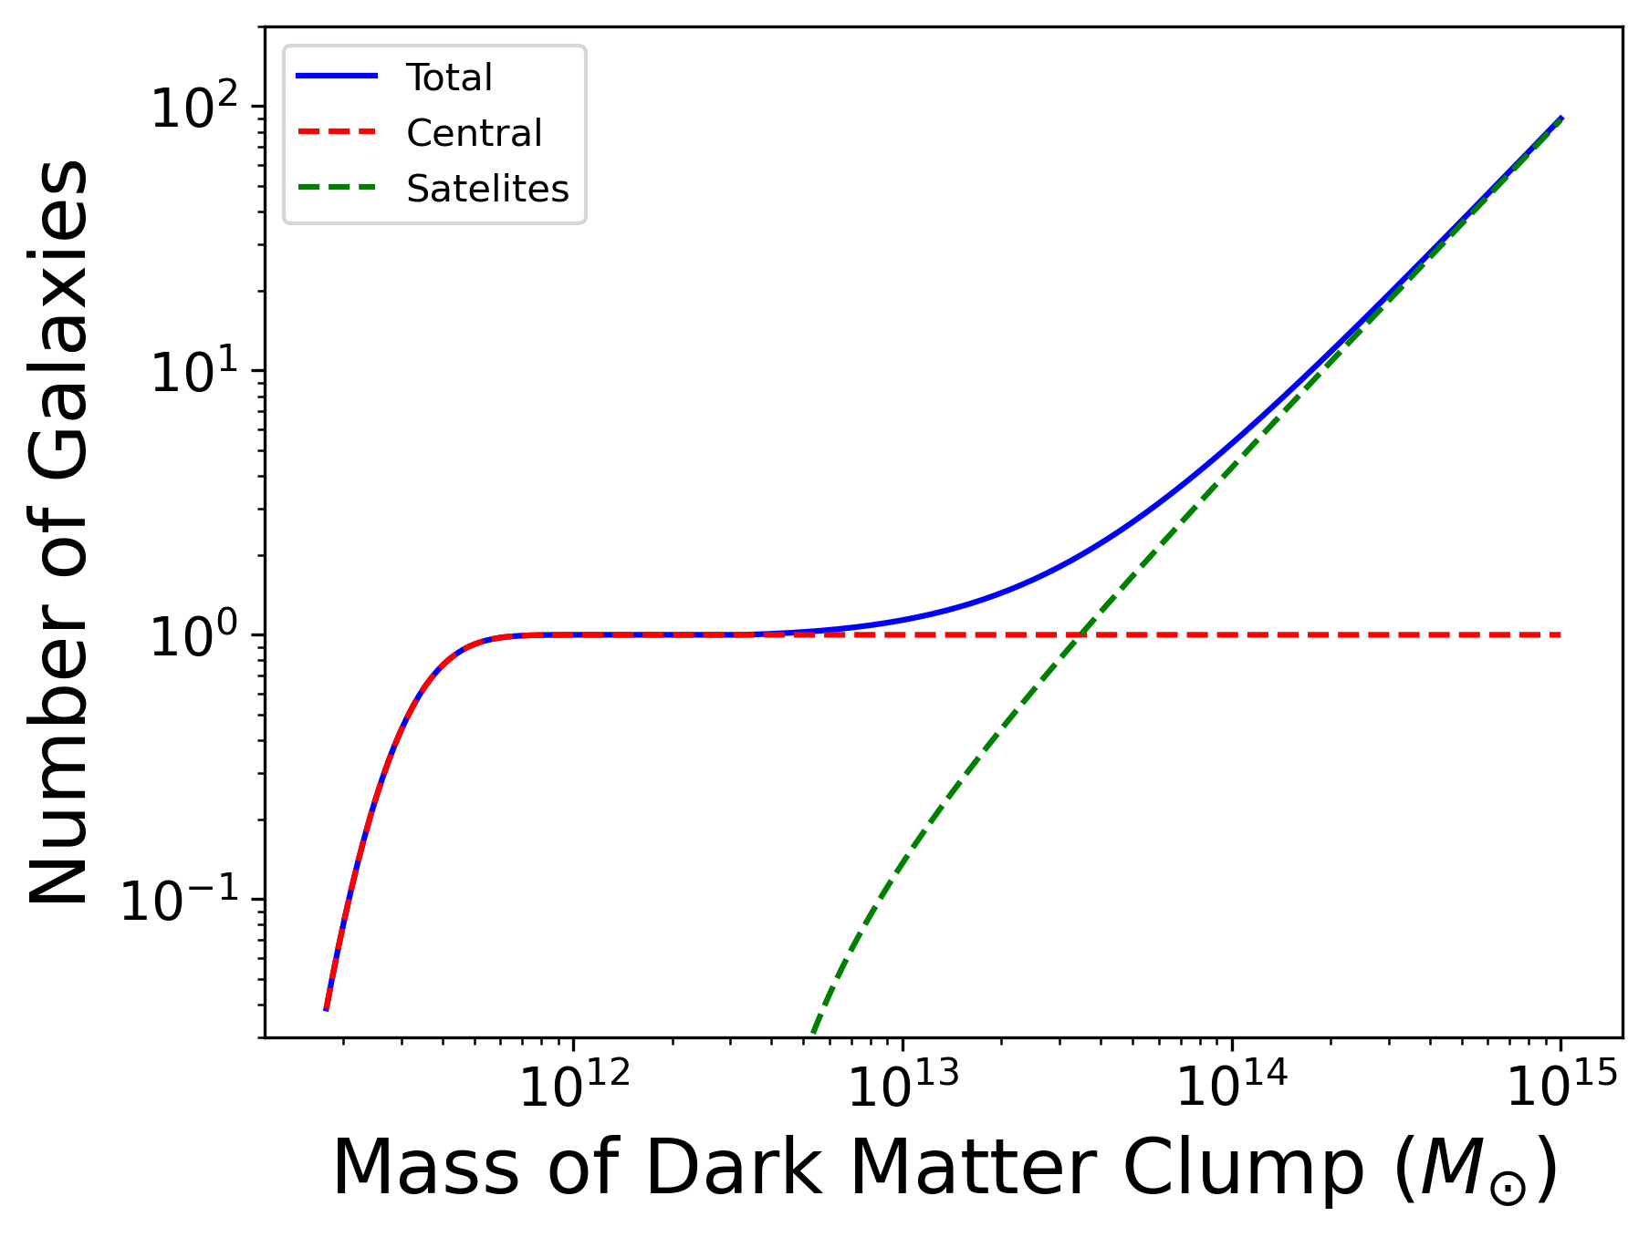
Determining Number of Galaxies
Entirely based on mass of the dark matter clump
Centrals, the brightest and most massive galaxies
Satellite galaxies orbiting the central
6

Slide 7
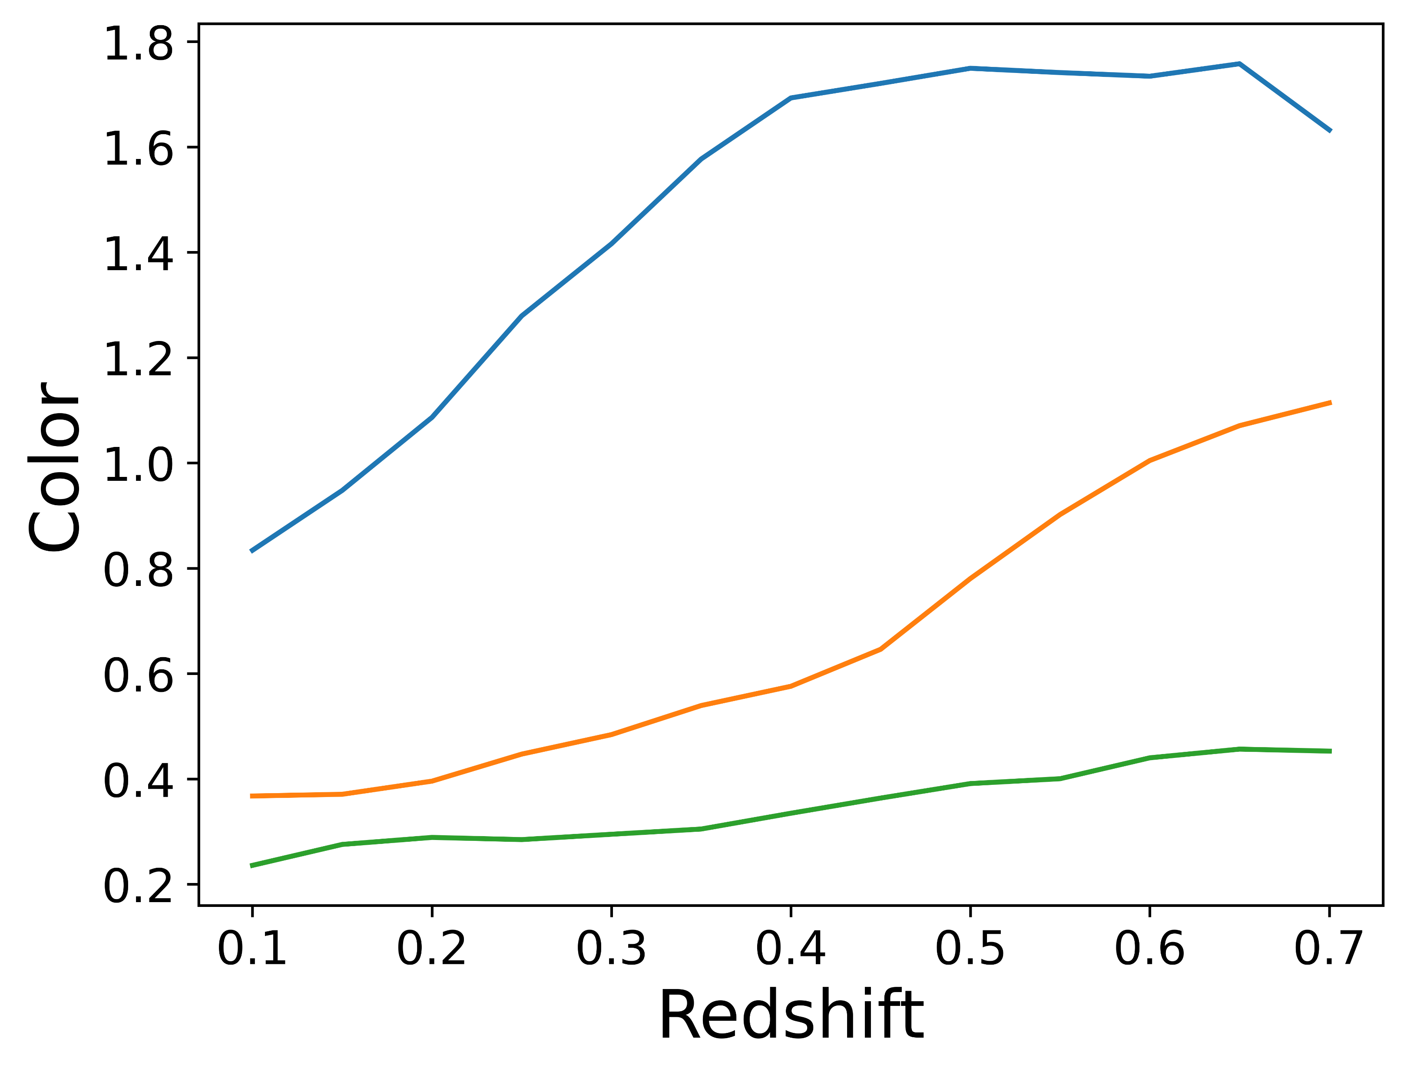
Determining Color of Galaxies
Color is difference in the brightness of different bands
Important property for cluster finding with redMaPPer
7

Slide 8
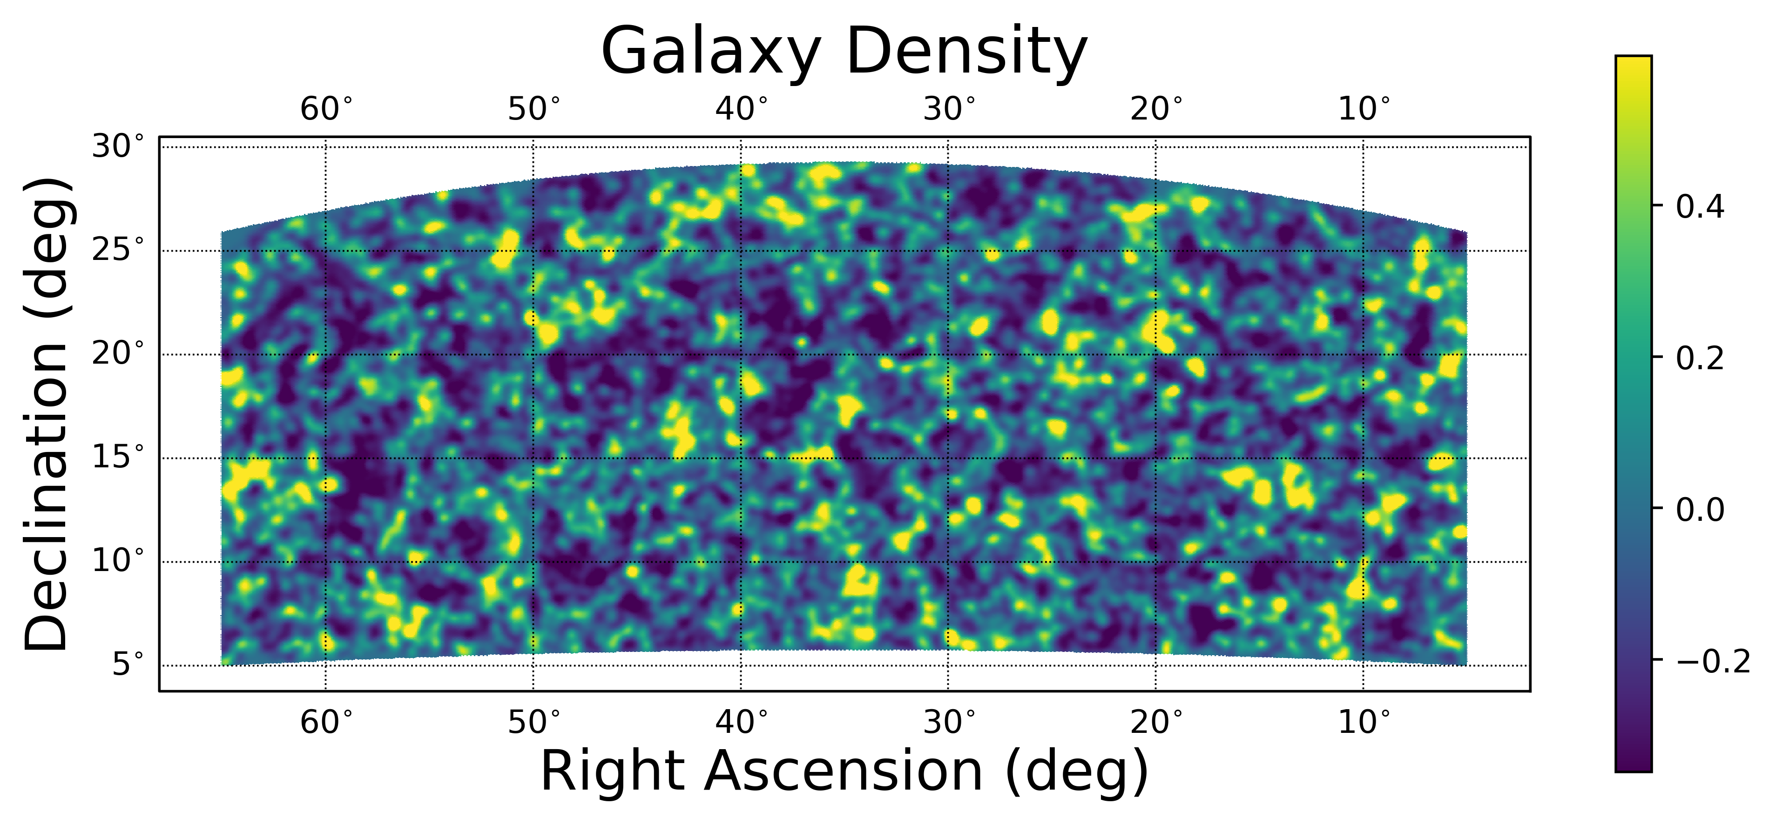
My Galaxy Simulation
Fast - creates a catalog of galaxies takes minutes, not hours
Accurate - includes photometric error and central brightening
8

Slide 9
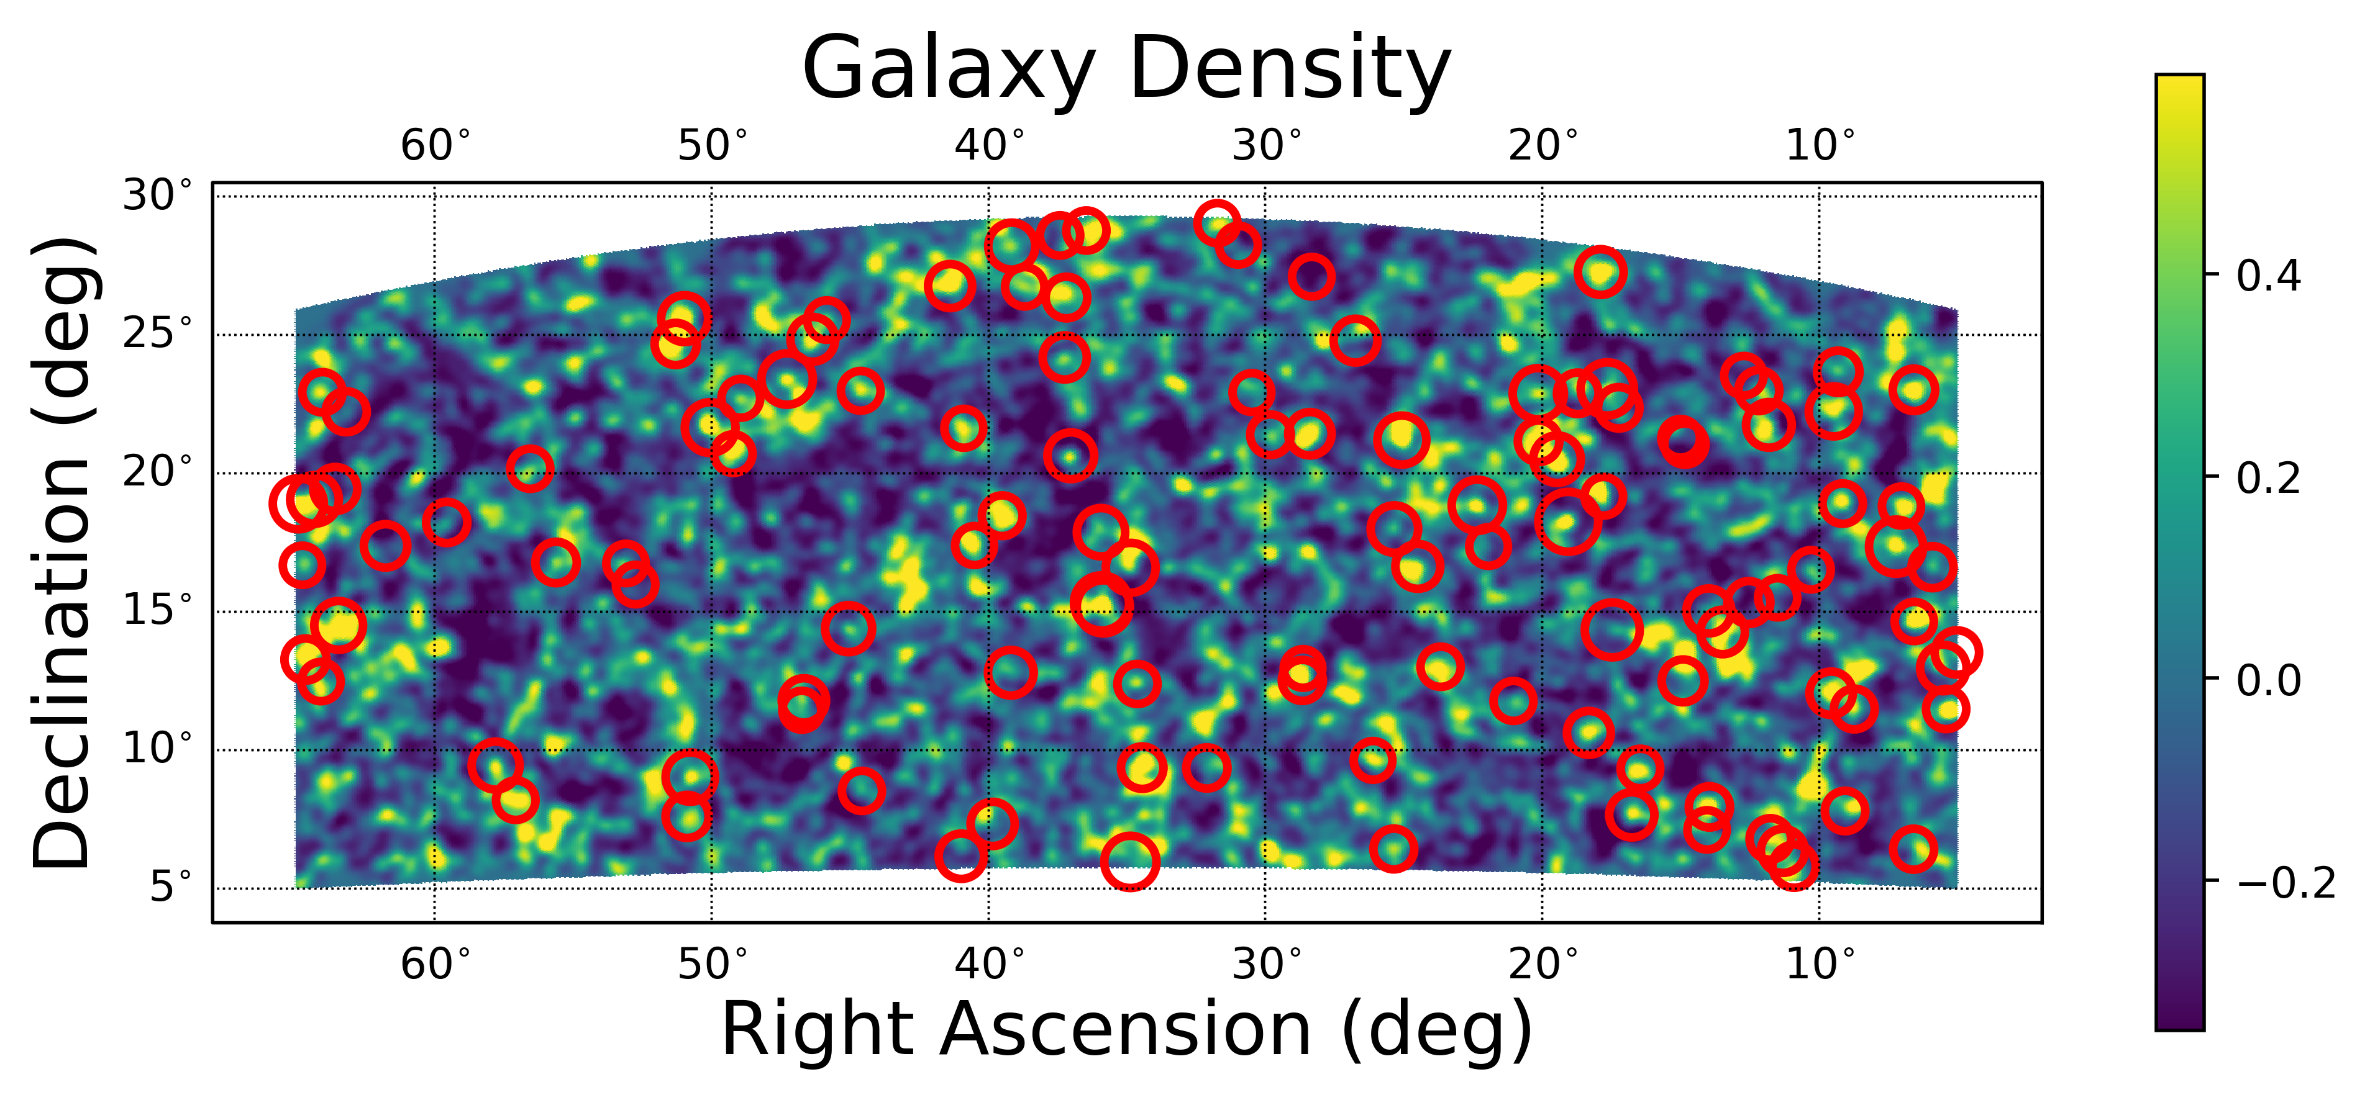
My Galaxy Simulation
Fast - creates a catalog of galaxies takes minutes, not hours
Accurate - includes photometric error and central brightening
8

Slide 10
Next Steps
Confirm accuracy to real world data
Use Dr. Salcedo’s method to measure cosmology
9

Slide 11
Thank You
Acknowledgements
Dr. Eduardo Rozo
Dr. Andres Salcedo
Arizona Space Grant Consortium
University of Arizona Department of Physics
For questions:
kfielder@arizona.edu

